Slide 1
Second Year B. Tech. Advanced Data Structures (CS228)
By
Dr. Pramod D. Ganjewar
Senior Assistant Professor,
School of Computer Engineering,
MIT Academy of Engineering, Alandi(D.),Pune

Slide 2
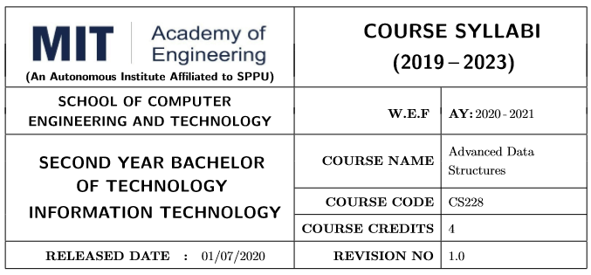
Course Information :- ADS (CS228)

Slide 3
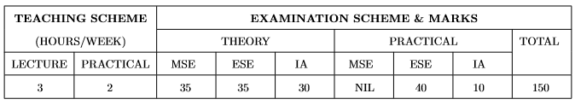

Teaching Scheme, Examination Pattern and Pre-Requisite

Slide 4
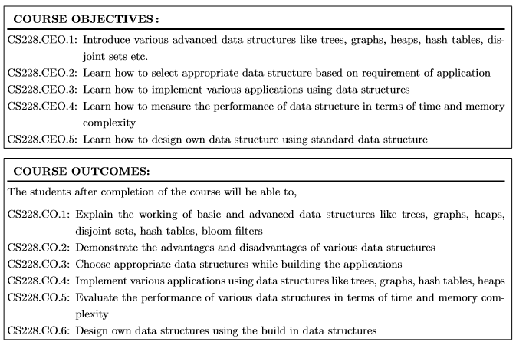
Course Objectives and Course Outcomes

Slide 5
Theory, Practical Course Contents, Text and Reference Books

Slide 6
Examination Schemes Theory and Practical
Type | Examination | Syllabus | Marks | Mode of Assessment | Weightage in Final Score | Total Marks
Theory (CS228T) | MSE | Unit No. 1,2 & 3 | 40 | MCQ Online Examination | 35 | 100
 | ESE | Unit No. 4 to 6 | 40 | MCQ Online Examination | 35
 | Internal Assessment | Unit No. 1 to 6 | 180 | Activity, Assignements, Quiz, Présentations etc. | 30
Practical (CS228L) | Continuous Assessment | Practical List | 140 | Practical performance | 10 | 50
 | End Sem Assessment | Quiz on all Practicals | 20 | MCQ Online Examination | 10
 |  | Practical List | 30 | Practical Exam | 30

Slide 7
Assignments and Activity Planning for Internal Assessment
Sr. No. | Name | Course Objective | Type of Assessment | LMS/ Tools Used | Marks | Tentative Date of Conduction
Assignment 1 | Unit - 1 | CO1,2 & 3 | Written Assignment | Collpoll | 20 | 20th Jan 2021
Assignment 2 | Unit - 3 | CO1,2 & 3 | Written Assignment | Collpoll | 20 | 16th Feb 2021
Assignment 3 | Unit - 4 | CO1,2 & 3 | Written Assignment | Collpoll | 20 | 28th Feb 2021
Assignment 4 | Unit - 5 | CO1,2 & 3 | Written Assignment | Collpoll | 20 | 20th March 2021
Activity 1 | Quiz on Unit 1 & 2 | CO1,2 & 3 | Quiz | Collpoll | 20 | 20th Feb 2021
Activity 2 | Quiz on Unit 3 & 4 | CO1,2 & 3 | Quiz | Collpoll | 20 | 20th March 2021
Activity 3 | Quiz on Unit 5 & 6 | CO1,2 & 3 | Quiz | Collpoll | 20 | 20th April 2021
Activity 4 | Flipped Classroom on Unit - 2. | CO4 | Presentation | Collpoll | 20 | 10th Feb 2021
Activity 5 | Jigsaw on Unit - 6. | CO5 | Presentation | Collpoll | 20 | 5th April 2021

Slide 8
Thank You

